Slide 1
FINAL PROJECT
Merit-DELTA
JS Full Stack-MEAN

Slide 2
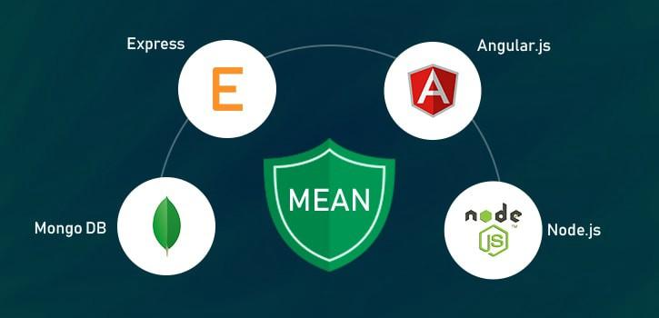
TECHNICAL REQUIREMENTS

Slide 3
DELIVERABLES
Wireframe using Balsamiq
Application Source Code(MEAN)
Database Schema Design

Slide 4
GOALS ACHIEVED
MoveOn is a relocation company.
Users can enter the requirement in a form and submit it.
Users are able to submit the form after filling the mandatory fields.
Once the save option is clicked the data will be stored in the browser temporarily and the next time when the user visits the page, the details are pre-filled.
Once the form is submitted after filling all the required information the same is updated in the database.
A Job number will be generated and displayed to the user after the submit.
In the format of DO-YYYY-MM-XXX (domestic - serial number) or IN-YYYY-MM-XXX (International - serial number).
User can submit as many applications as they want – no limit.
All submitted requests are been listed as a simple report grouped as Domestic and International in reverse chronological order.

Slide 5
WIREFRAME

Slide 6
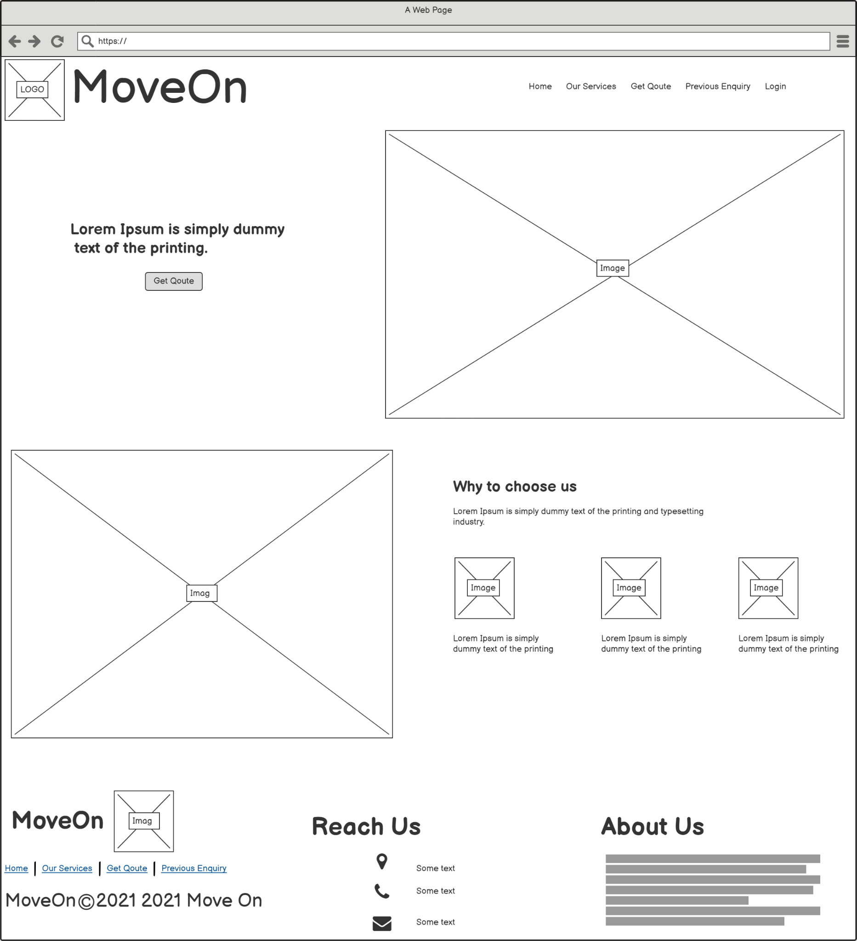
Home

Slide 7
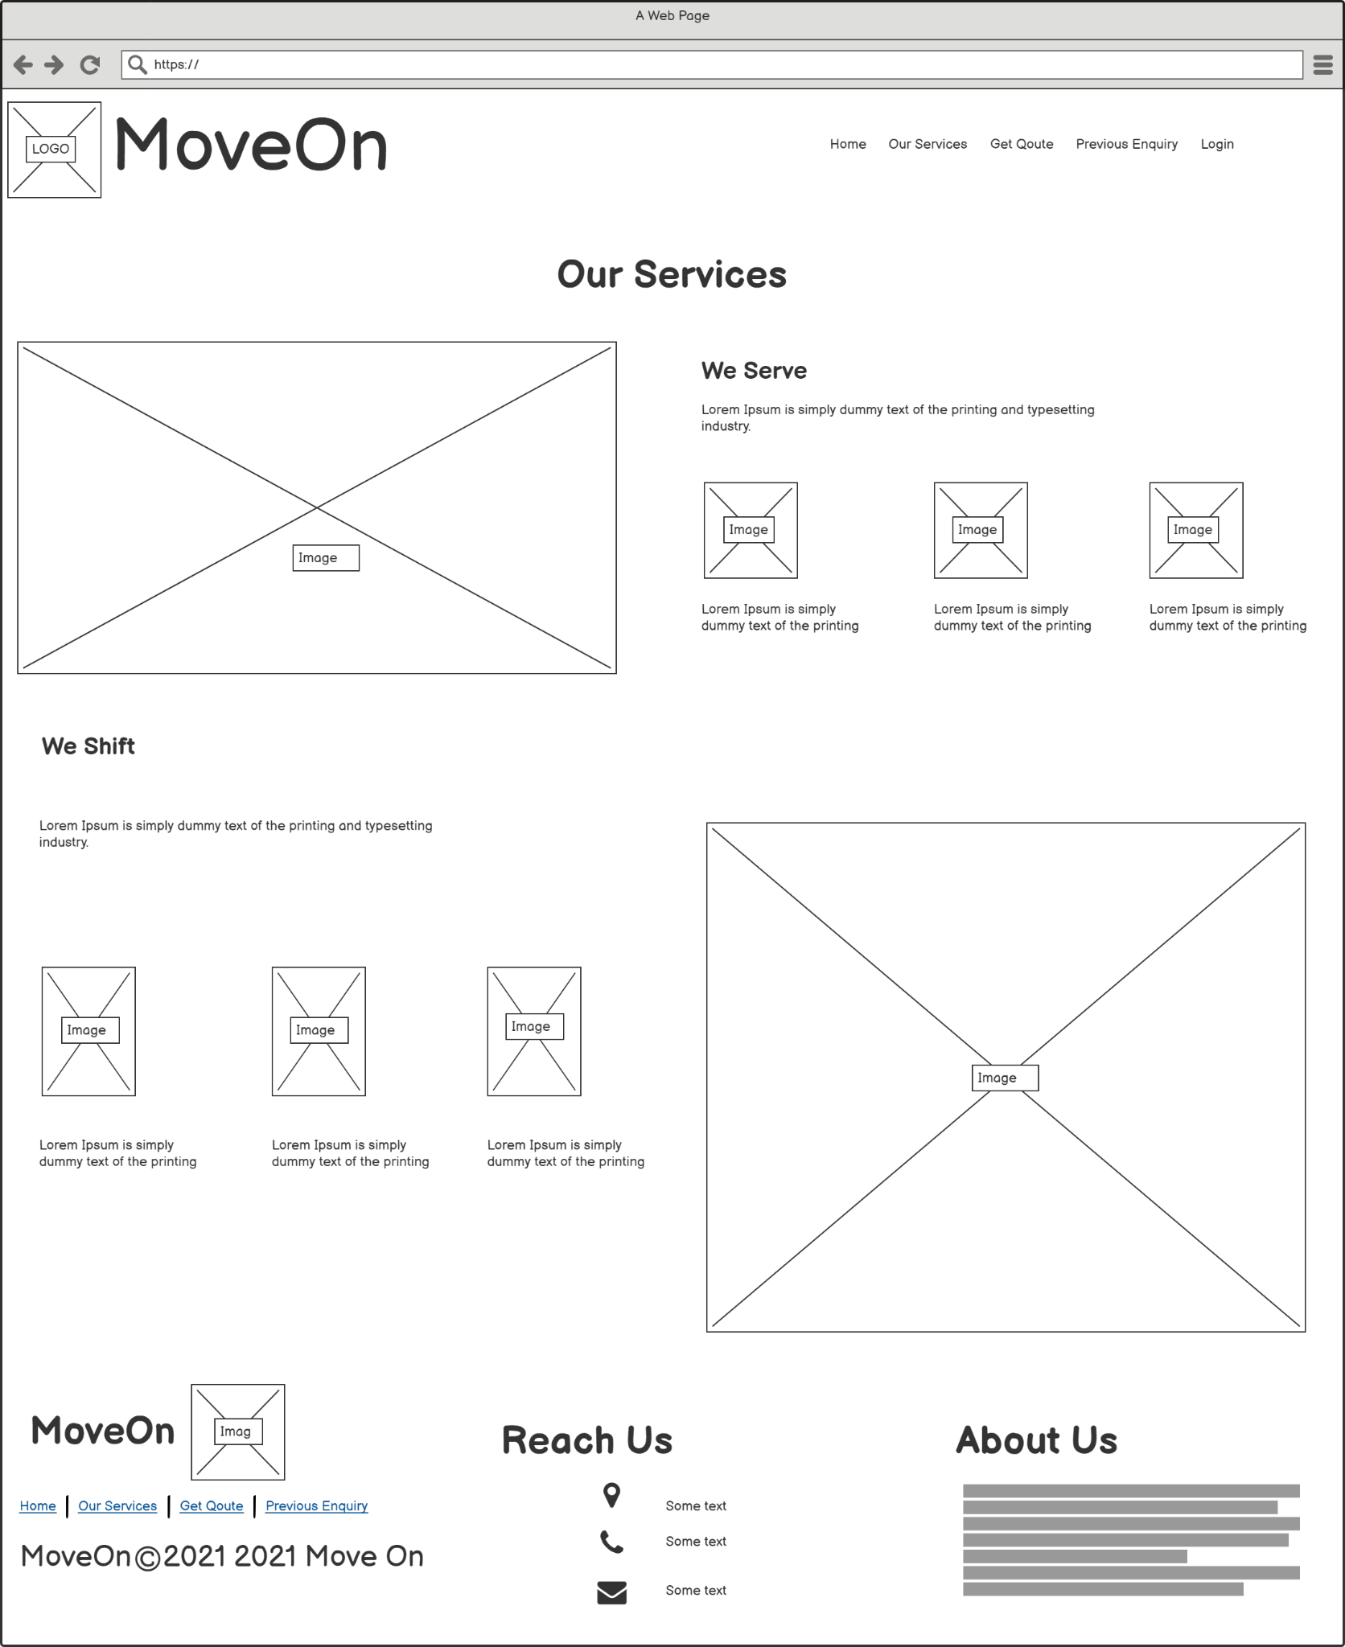
Services

Slide 8
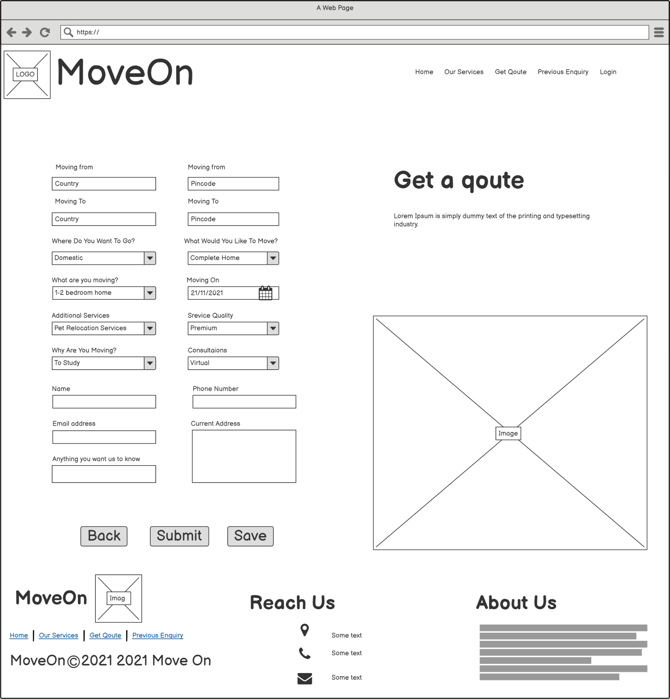
Get Quote

Slide 9
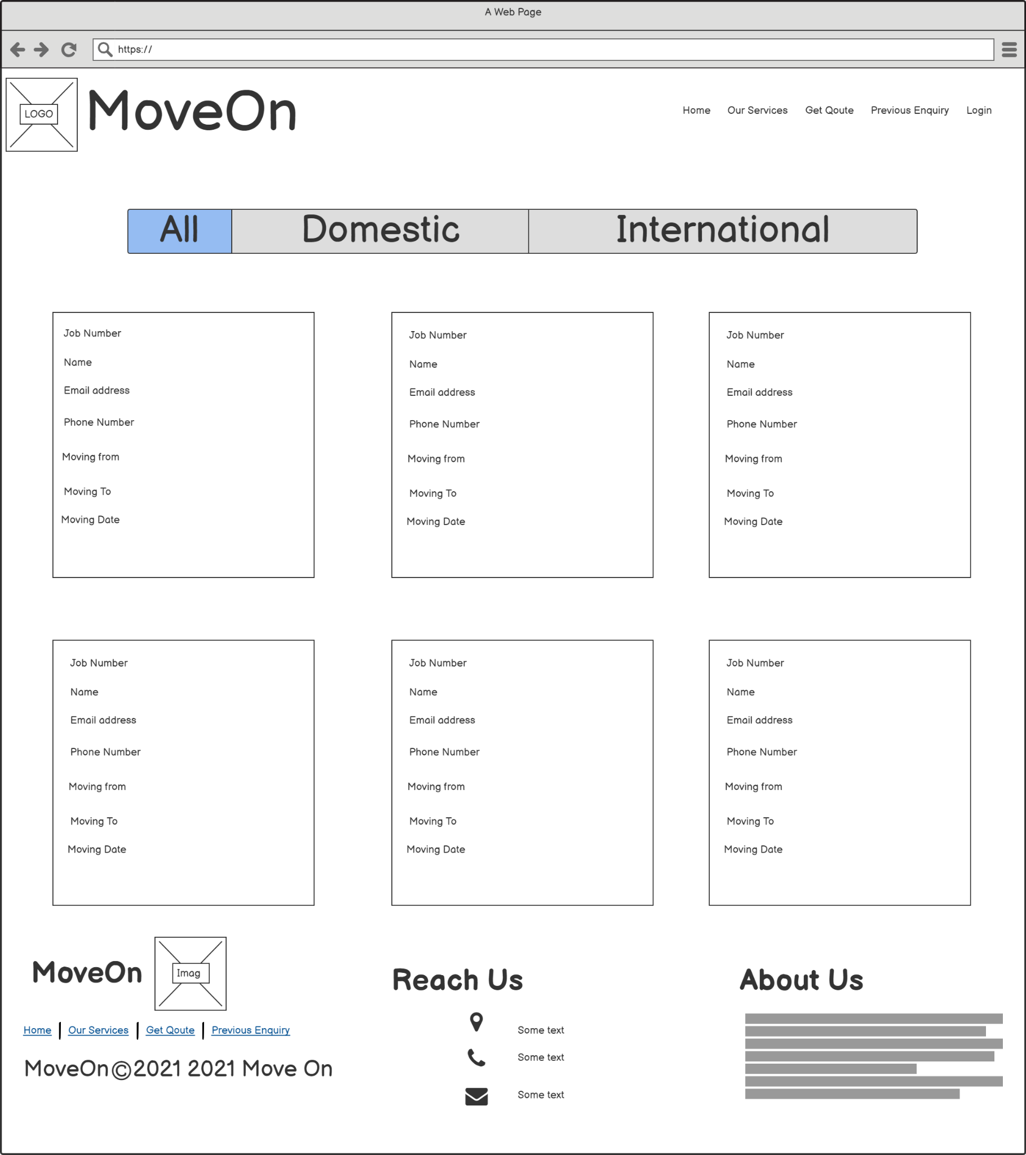
Previous Enquiry

Slide 10
Repository URL
https://github.com/Balaji8898/FinalProject

Slide 11
TIMELINE
Day 2
Day 4
Day 1
Day 6
Day 3
DAY 5
UserInterface 50%
Connect API and UI
WireFrame & Database Design
Generate application number.Creating a prefilled form
Node API and UI
Adding validations and creating a response and displaying responses

Slide 12

CREDITS
RAVI VO
SURESH SUBRAMANI
SATHISH KUMAR VIJAYAN

Slide 13
THANKS!

